Slide 1
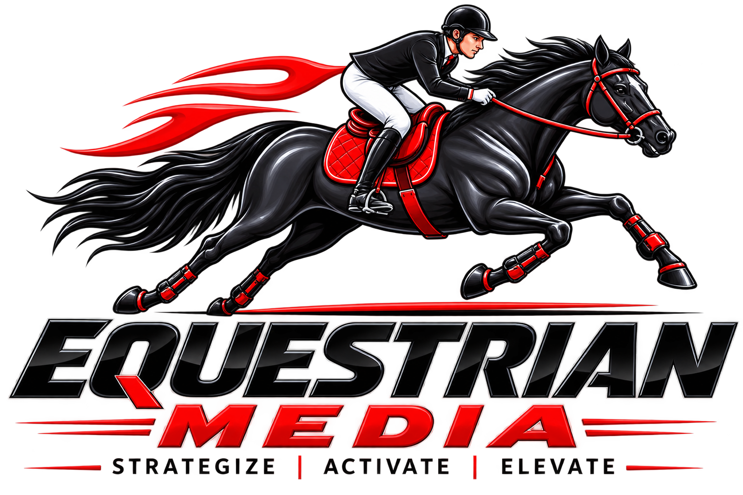
WELCOME
Equestrian Media Pvt. Ltd.

Slide 2
About Us
About Equestrian Media
Equestrian Media Private Limited is a Hyderabad-based BTL Marketing, Brand Activation, and Outdoor Advertising Company Headquartered in HITEC City, Kothaguda.
We specialize in delivering innovative on-ground marketing campaigns that connect brands directly with their target audience. Our customized BTL solutions help businesses increase brand visibility, customer engagement, and market reach across Telangana and Andhra Pradesh
Equestrian Media Pvt. Ltd.

Slide 3
What we do
Brand Activation
Product Launches
Mall Activations
Retail Promotions
Corporate Events
Road Shows
Mobile Advertising
Tata Ace LED Vans
Bolero LED Vehicles
Auto Hood Branding
T-Shape Auto Branding
Auto Boom Campaigns
Outdoor Advertising
Digital Wall Posters
Pole Kiosks
Flex Hoardings
No Parking Boards
Street Branding
Promotional Campaigns
Tricycle Campaigns
Walkers & Look Walkers
Pamphlet Distribution
Sampling Activities
Society Promotions
Equestrian Media Pvt. Ltd.

Slide 4
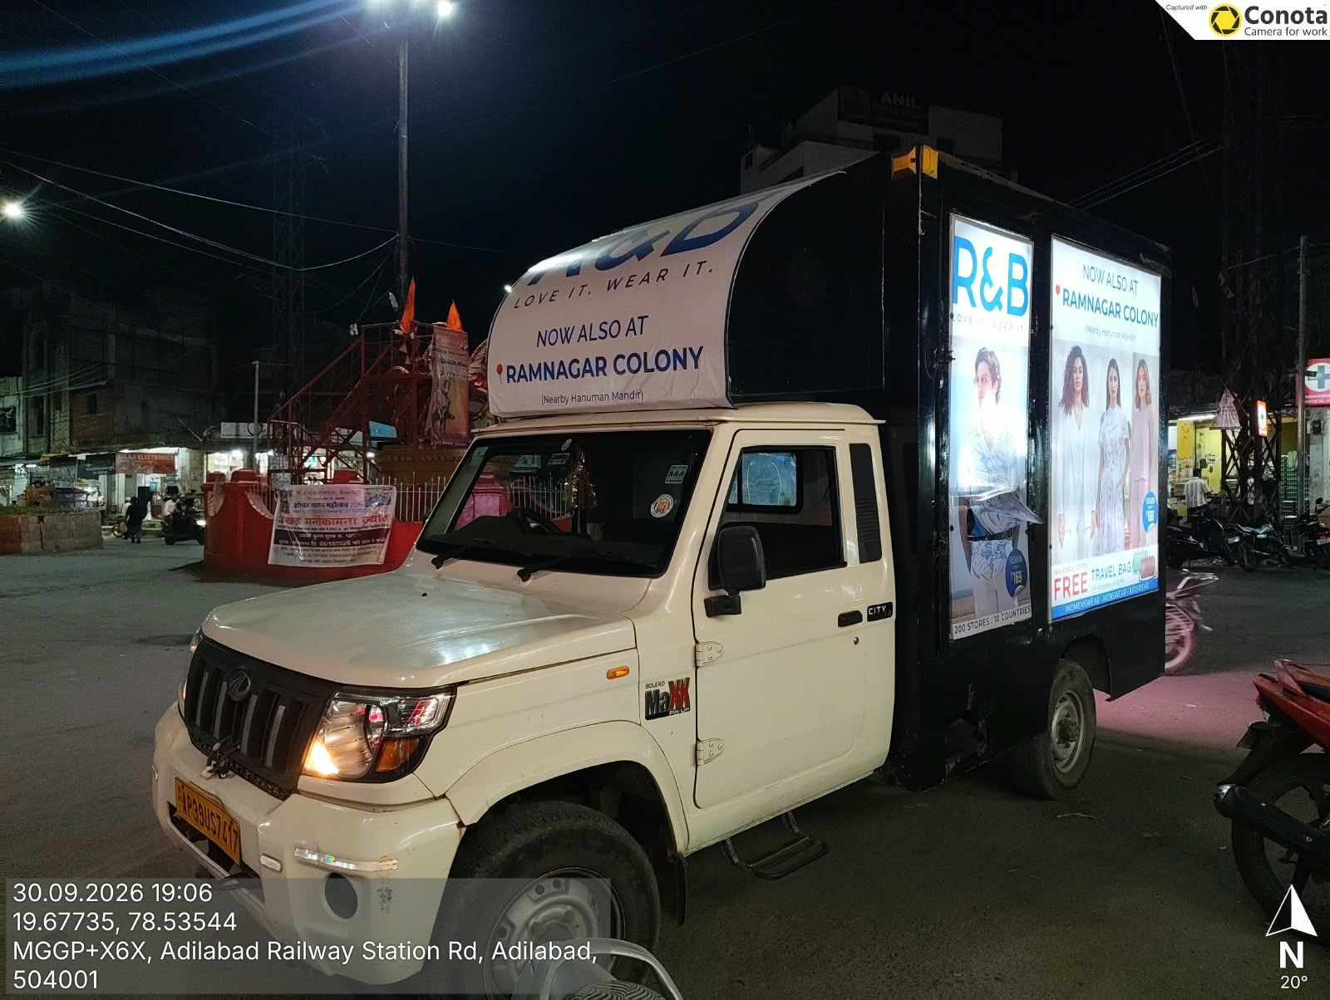
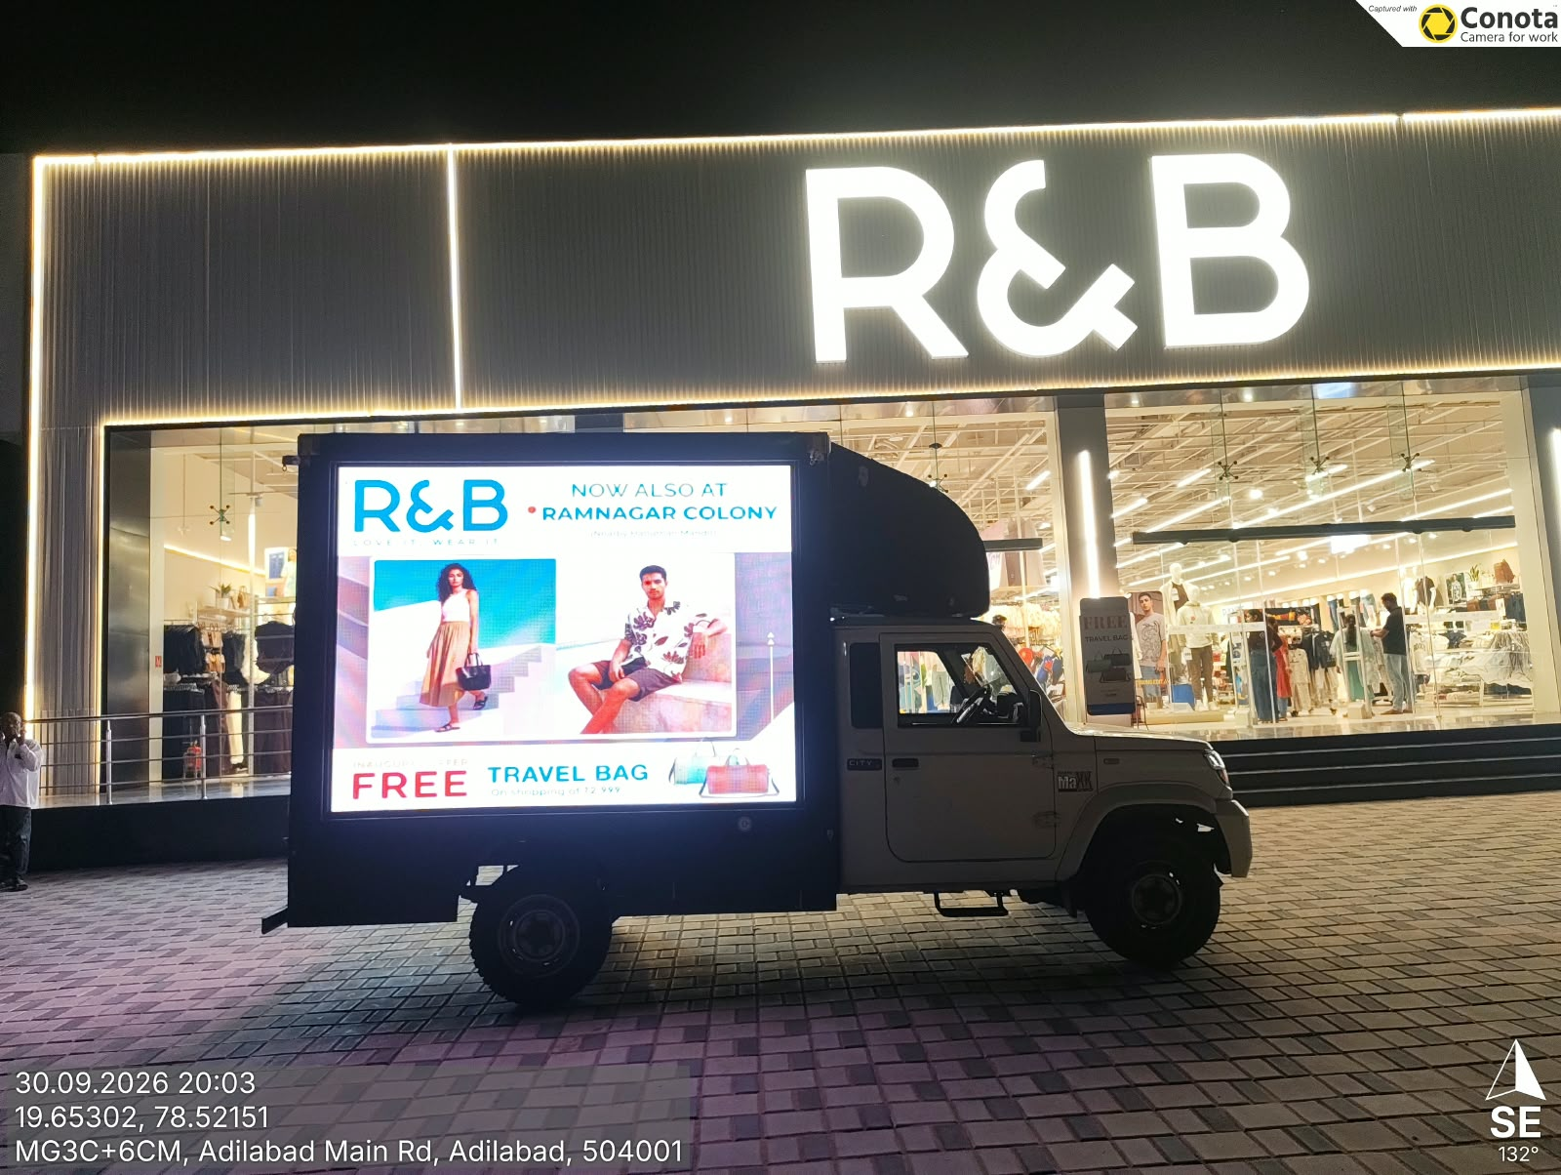
Cost for 1 Month Rs.250000/-

Slide 5
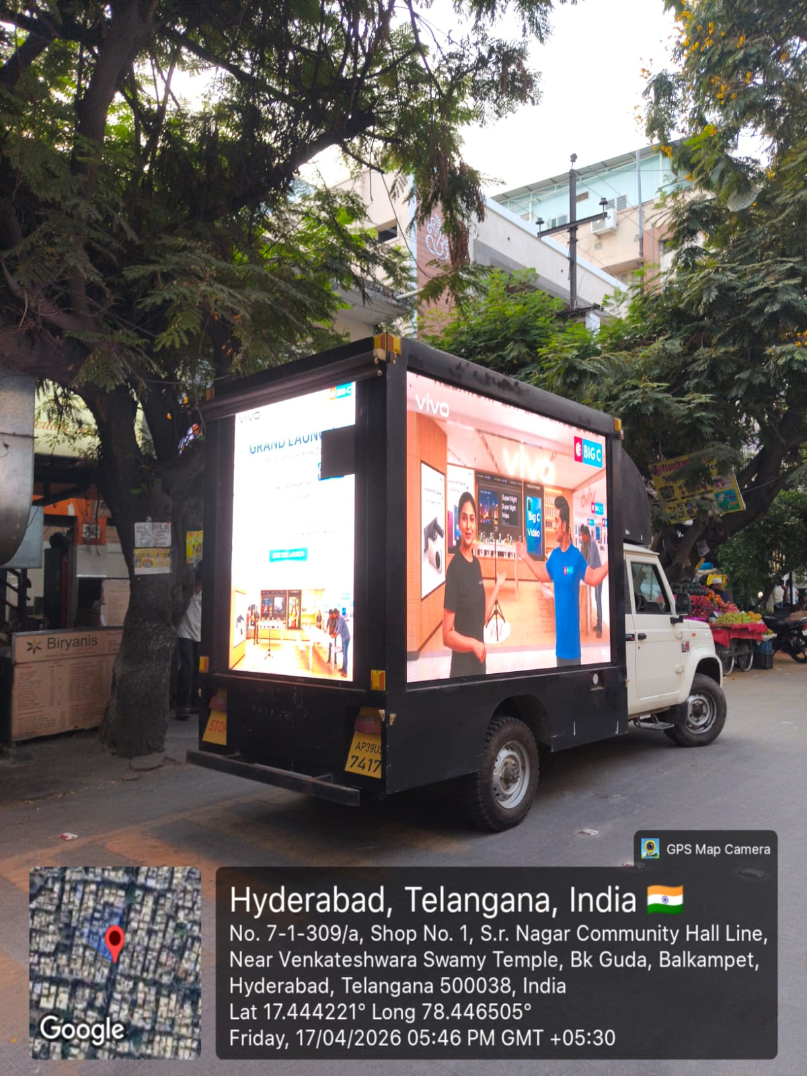
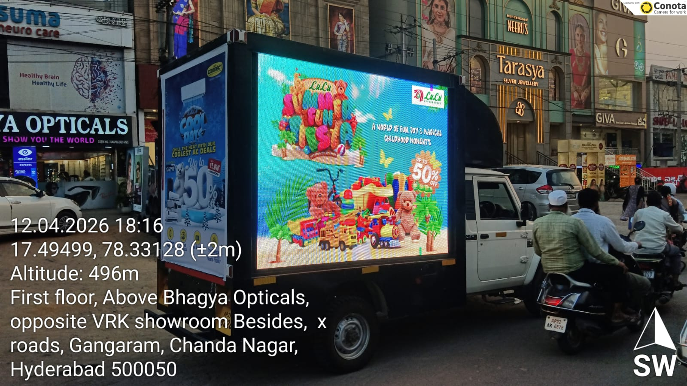
Cost for 1 Month Rs.250000/-

Slide 6
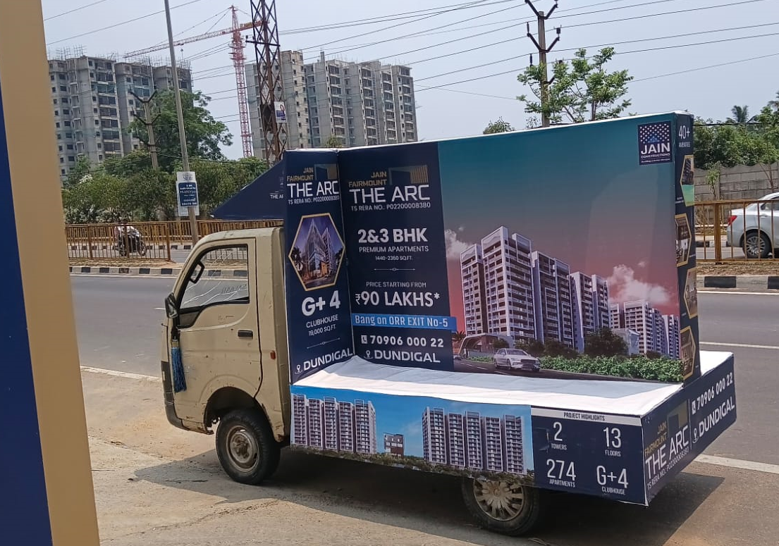
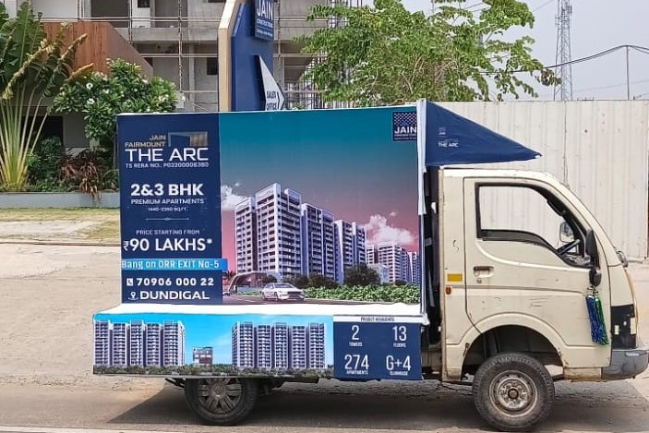
T SHAPE Auto Rs.75000 per Month 50 Kilometers 8 Hrs.

Slide 7
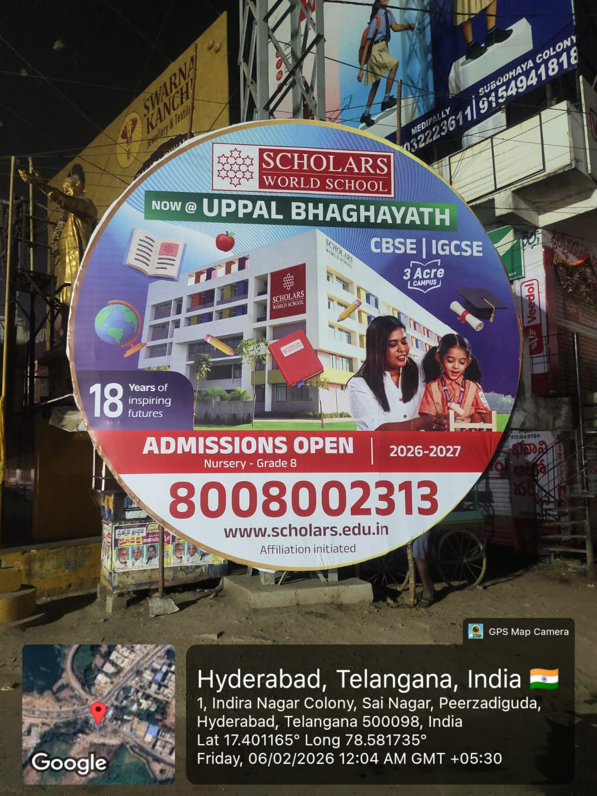
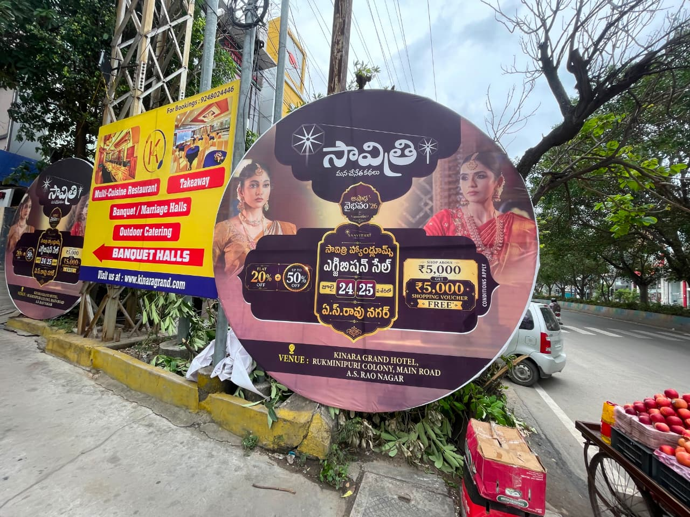
Round Flex Rs.9000/- for 15 X15 Size

Slide 8
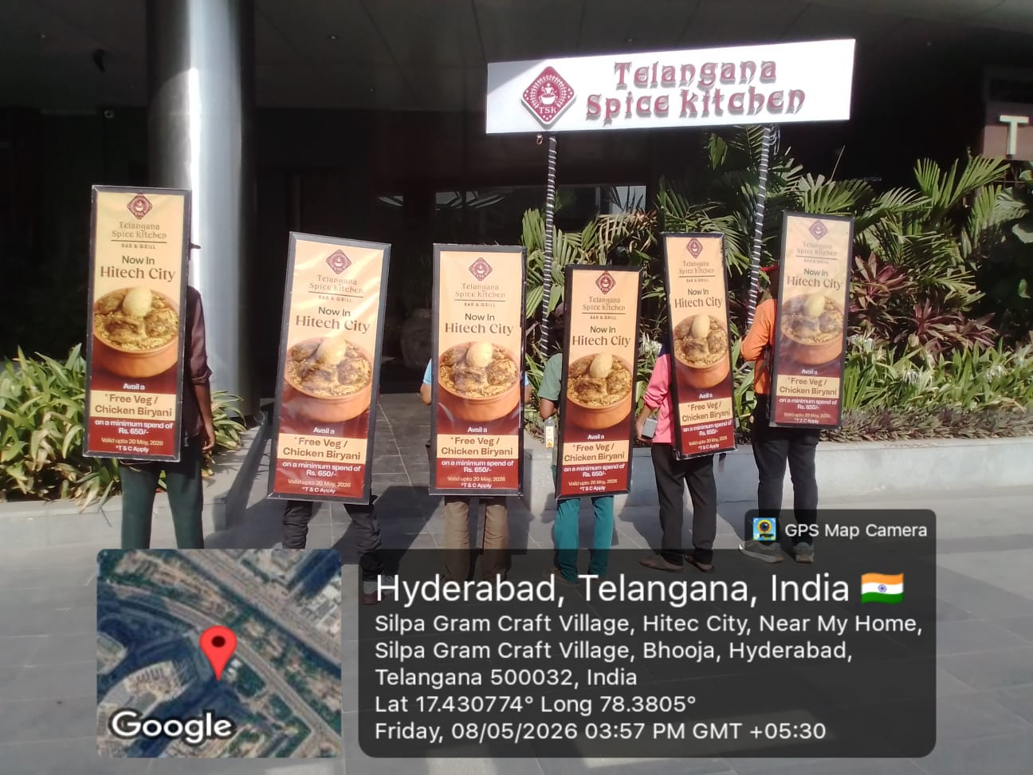
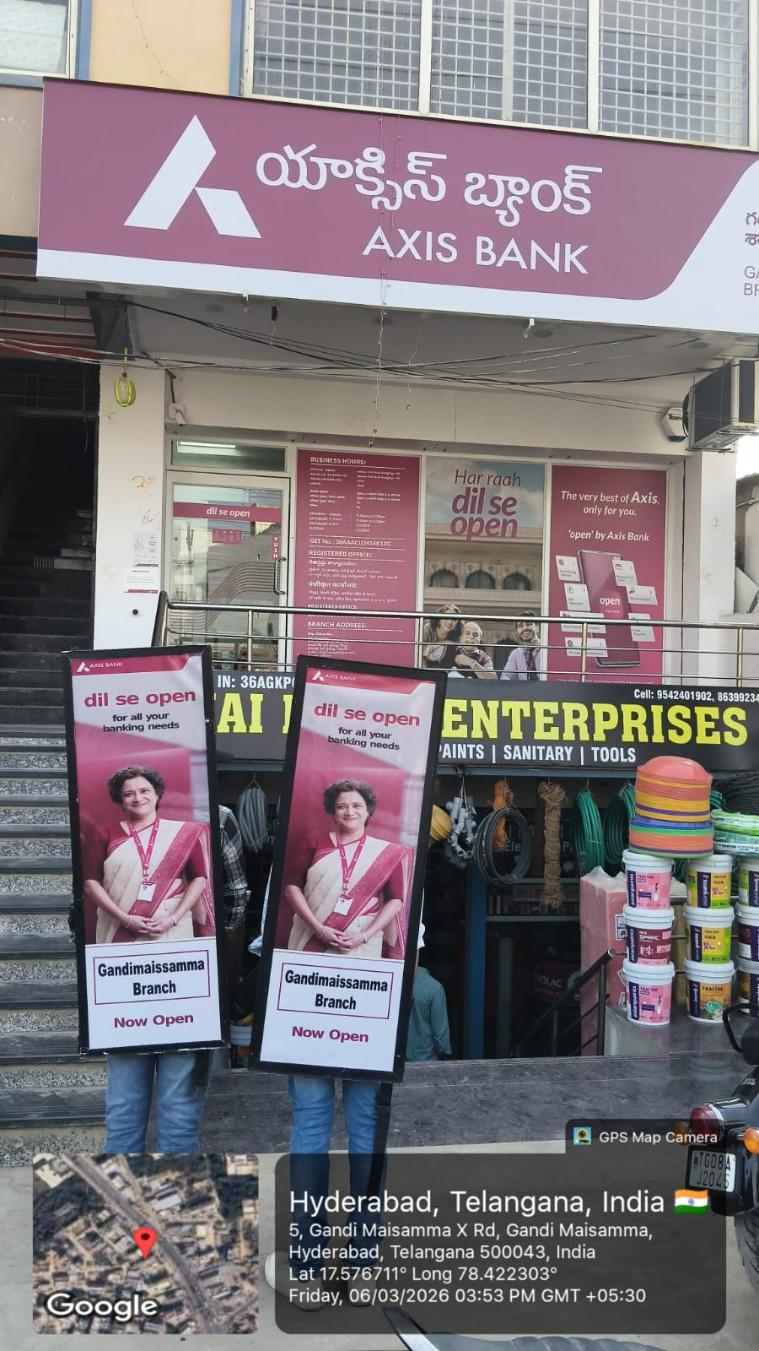
LOOK WALKERS – 1300 Per day

Slide 9
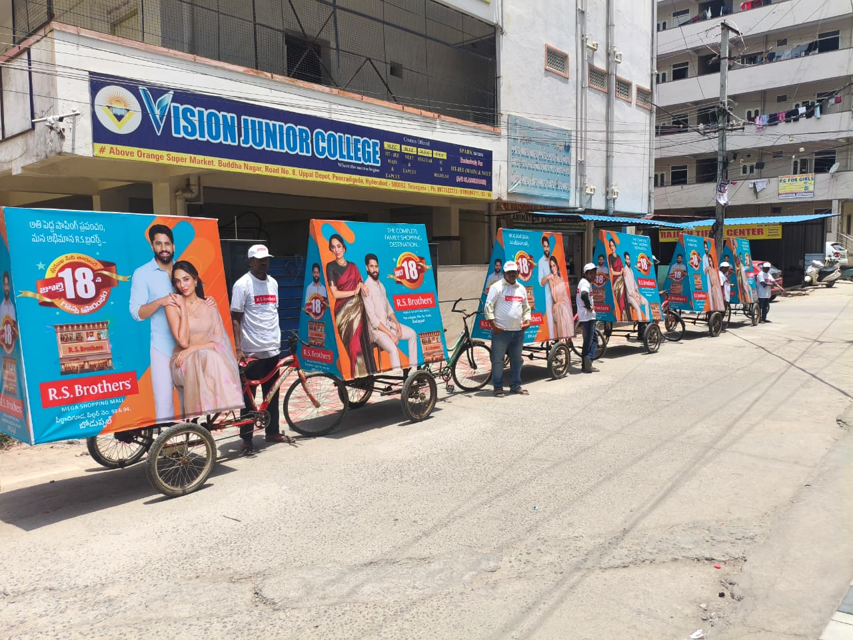
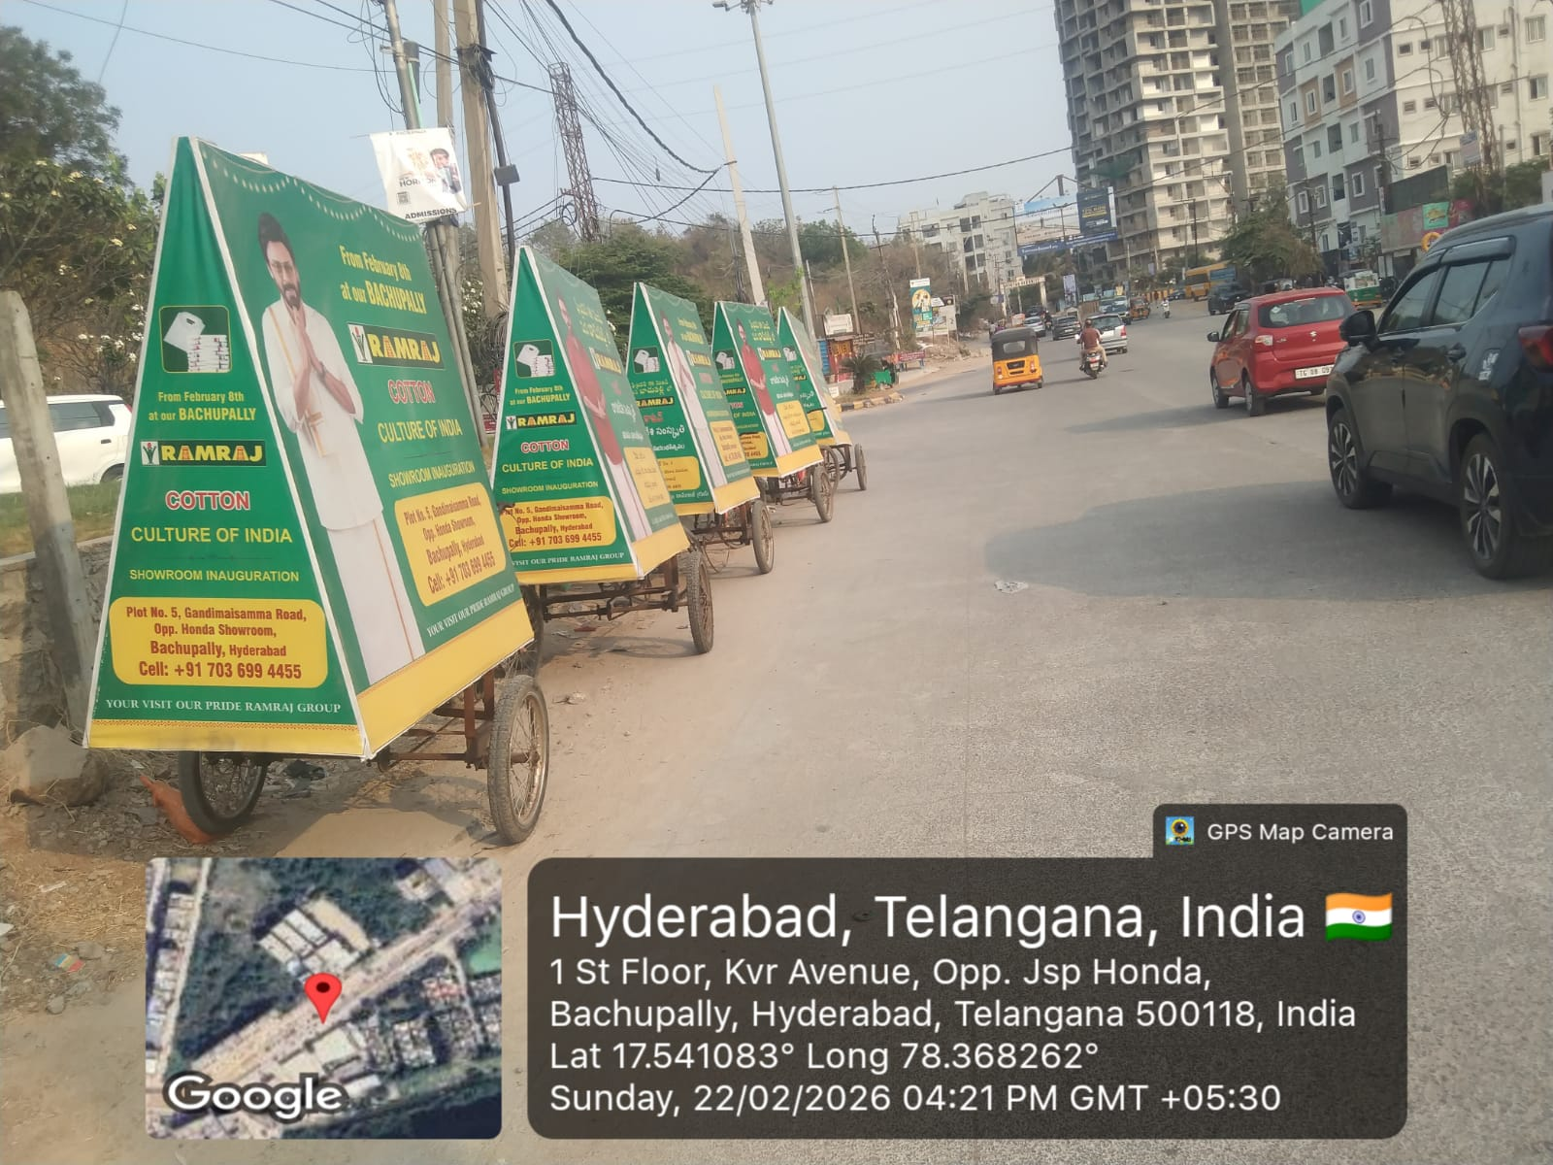
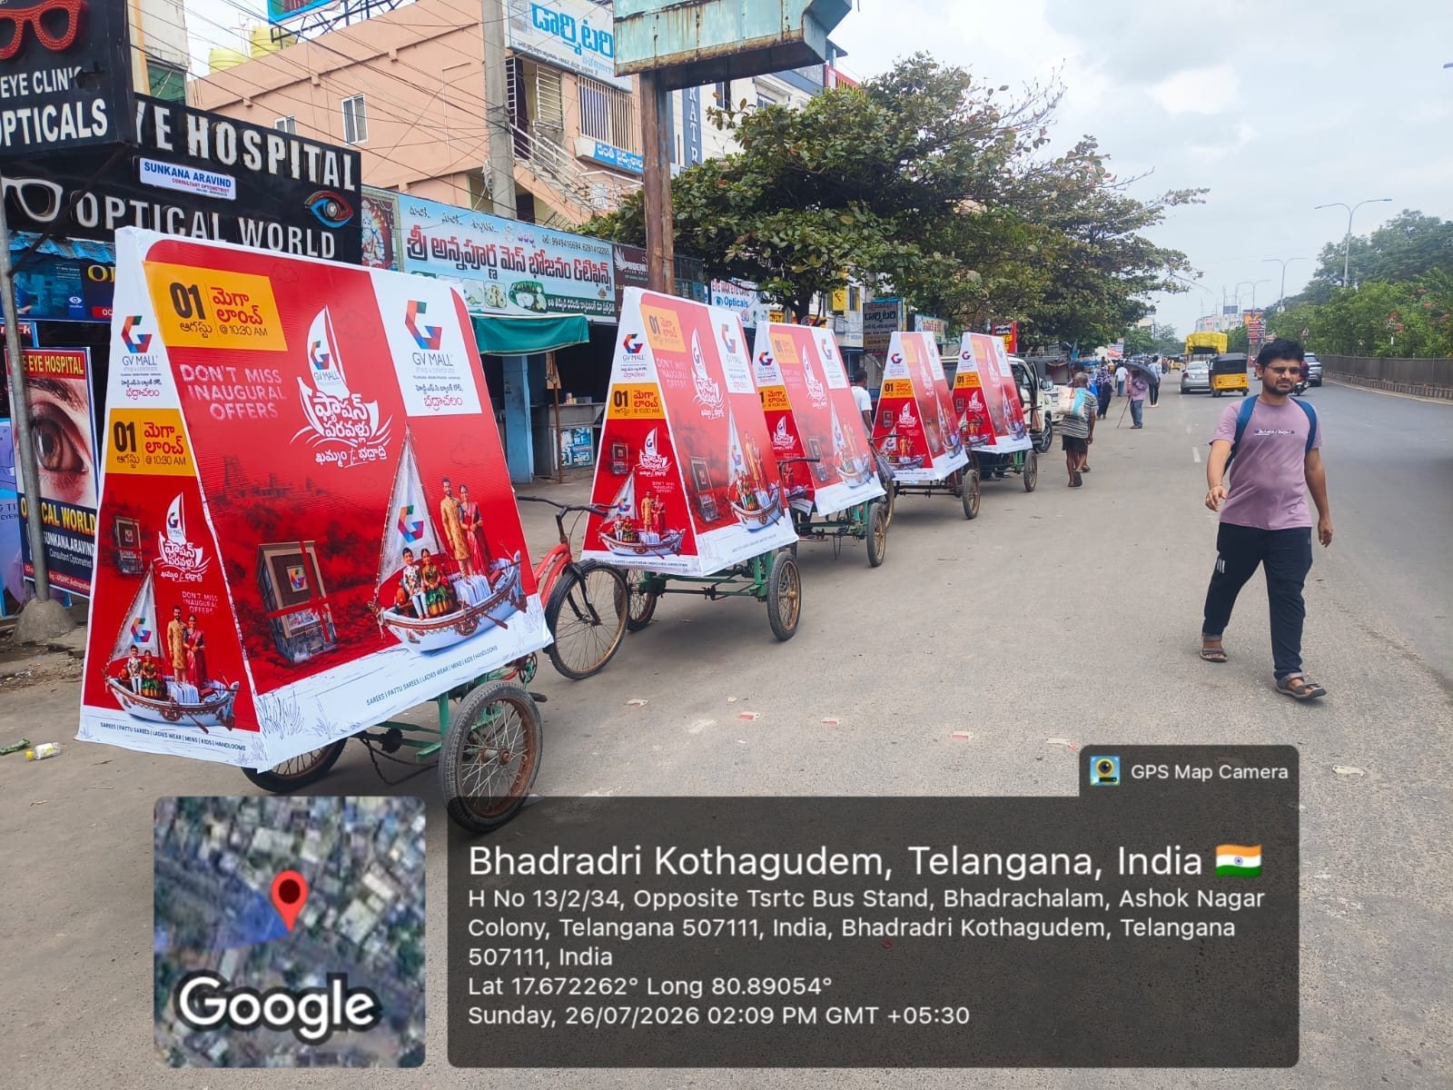
TRICYCLE Campaign Cost for Day Rs.1500

Slide 10
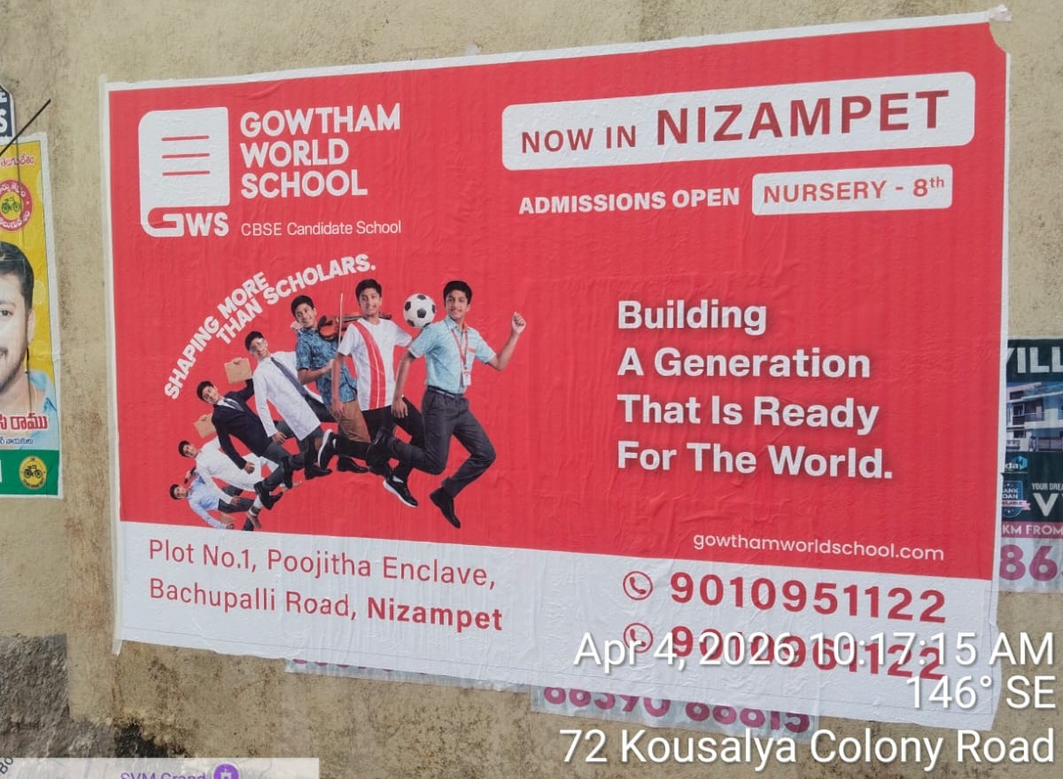
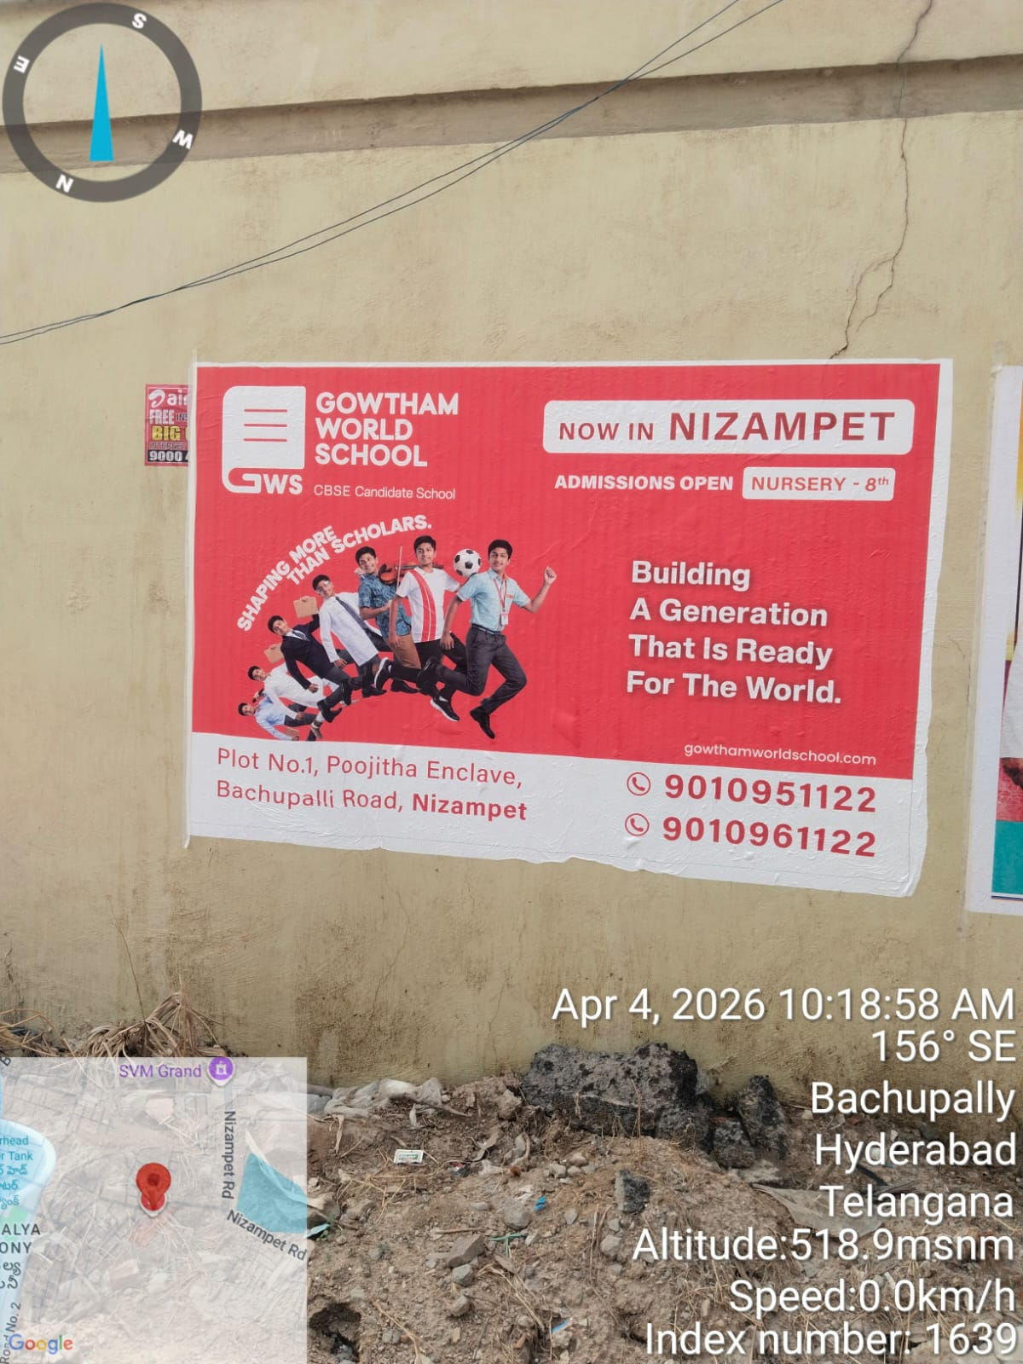
DIGITAL WALL Poster per Sft Rs.22

Slide 11
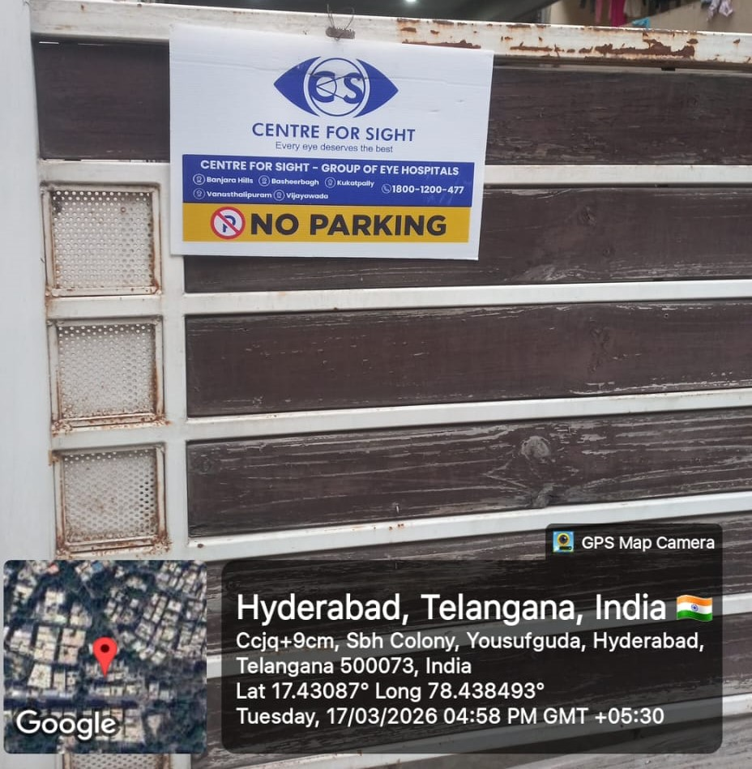
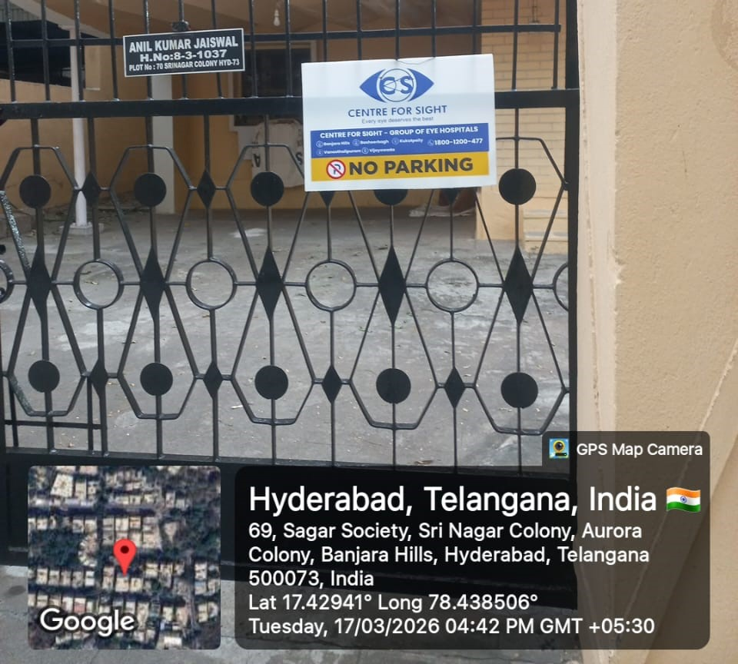
No Parking Boards Size 18 Inches X 12 Inches
Each Rs.29 for Broad Min Quantity 500

Slide 12
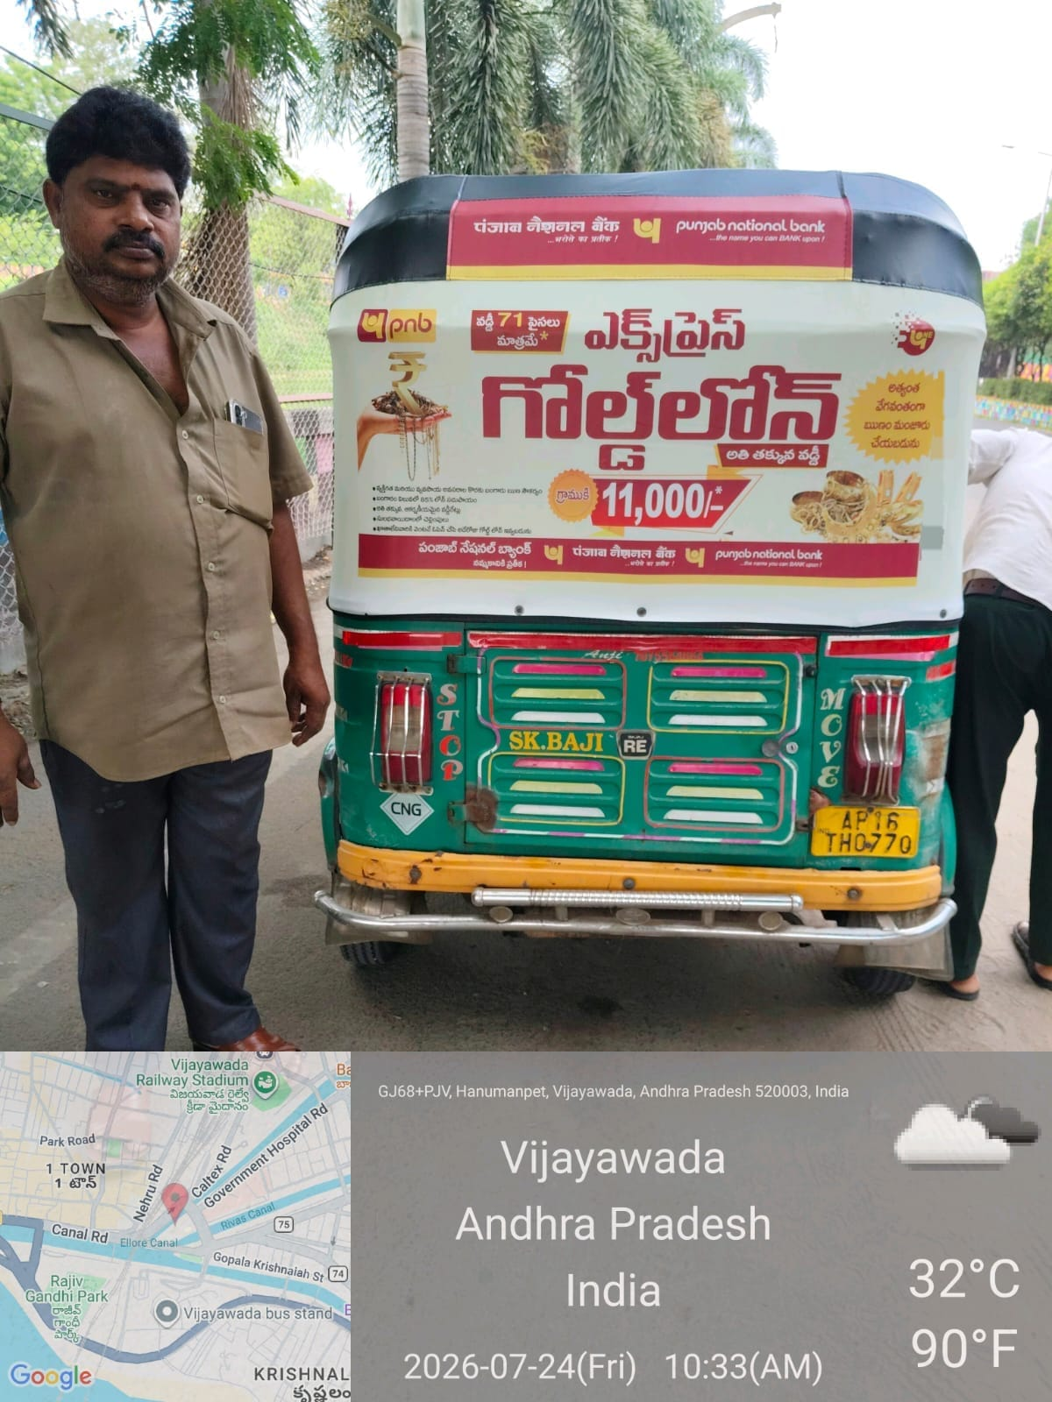
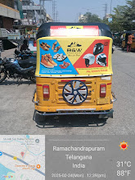
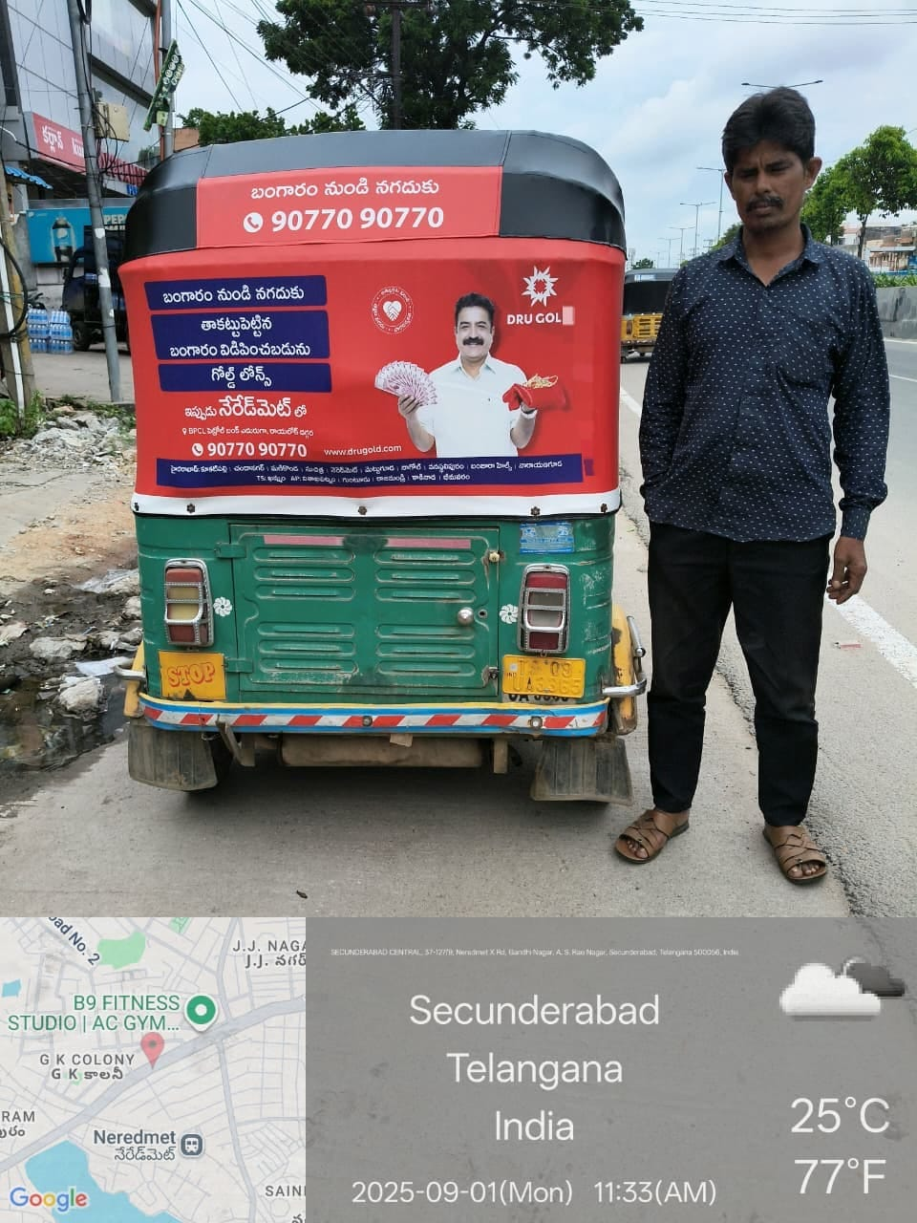
AUTOTOP Rexene Rs 650/- per Auto including Pasting Minimum Quantity 500

Slide 13
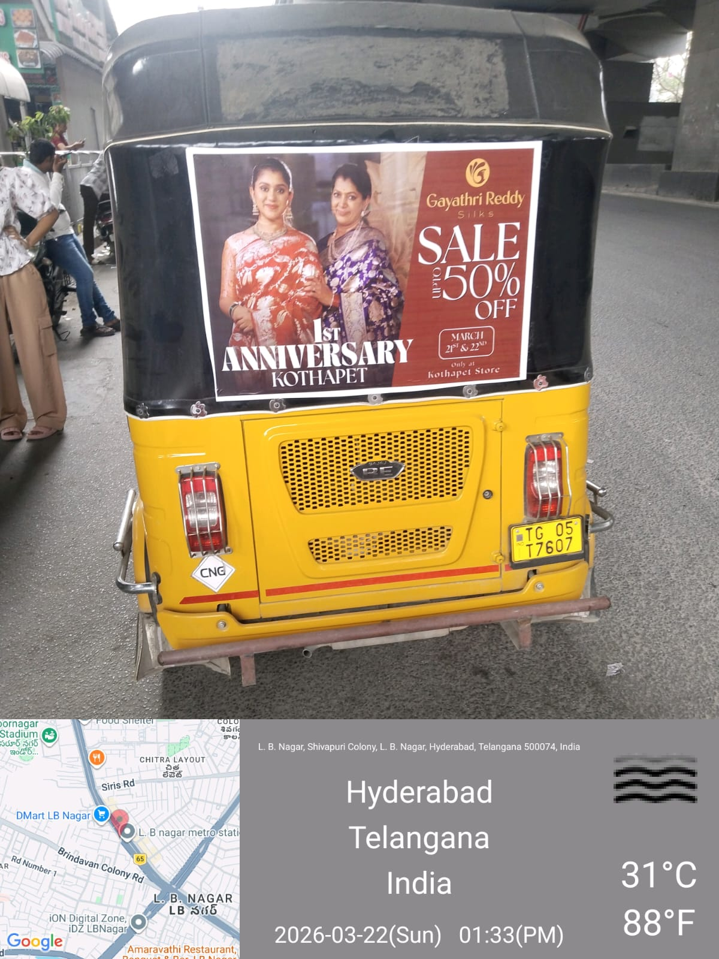
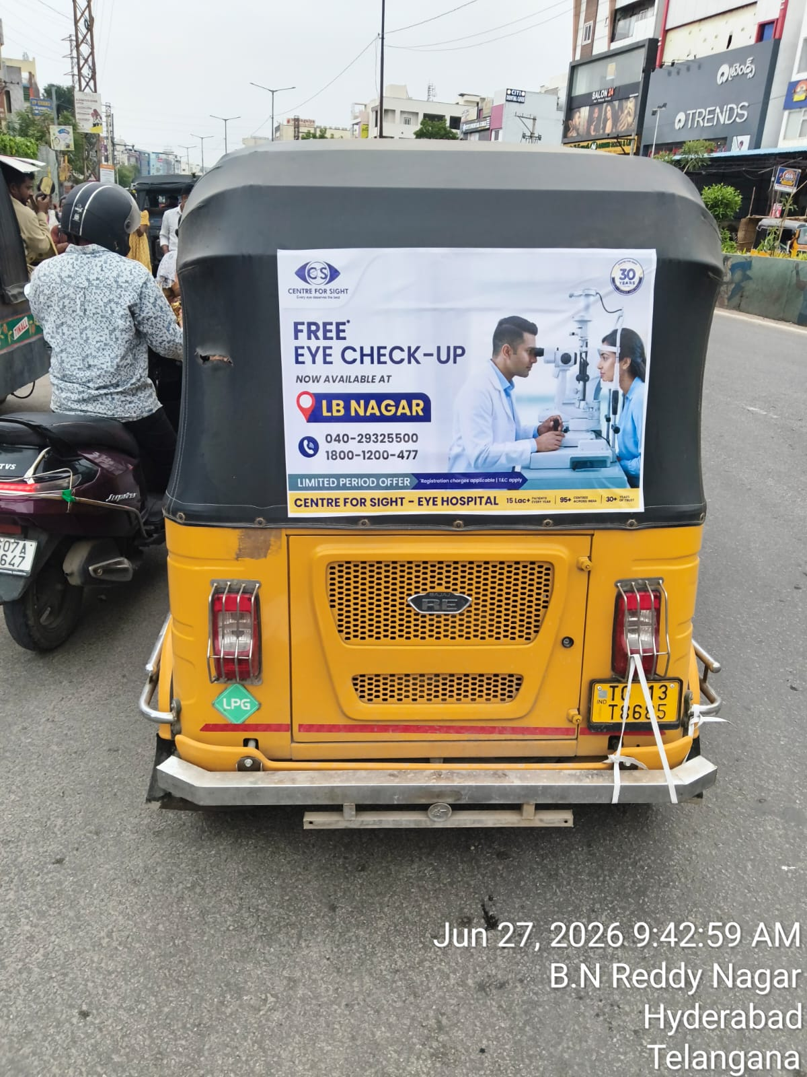
AUTO Stricter Rs.120

Slide 14
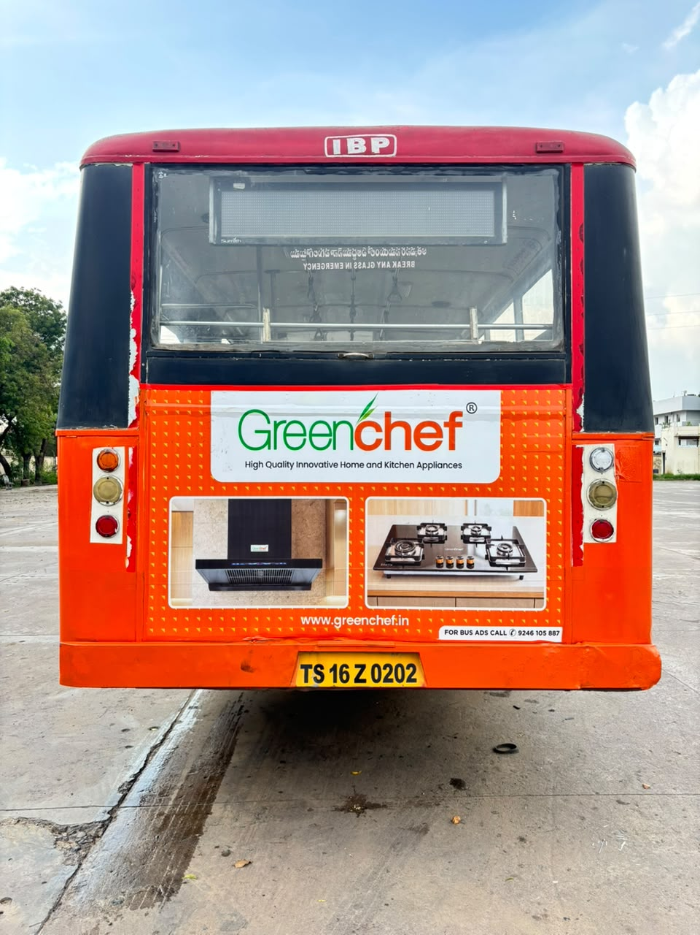
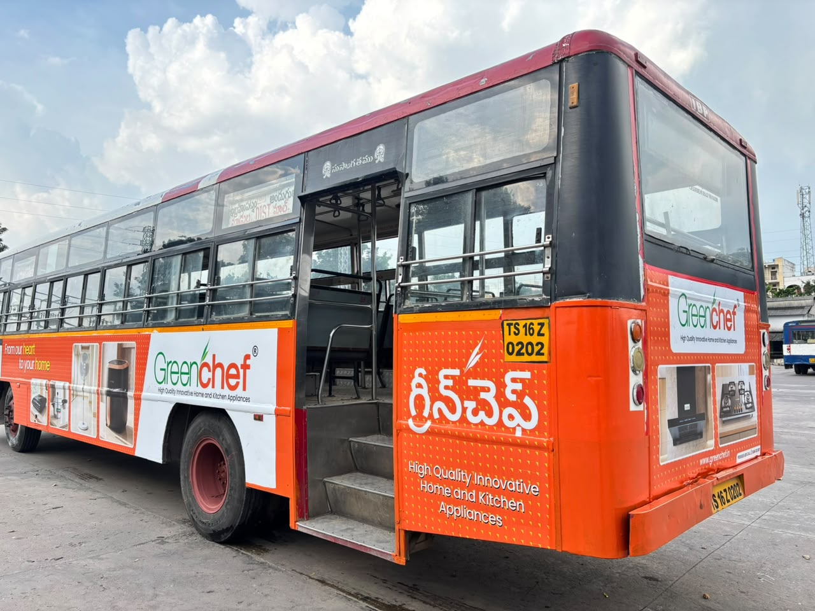
BUS ADS Rs.40000 Per Month + 7500 Printing and Mounting

Slide 15
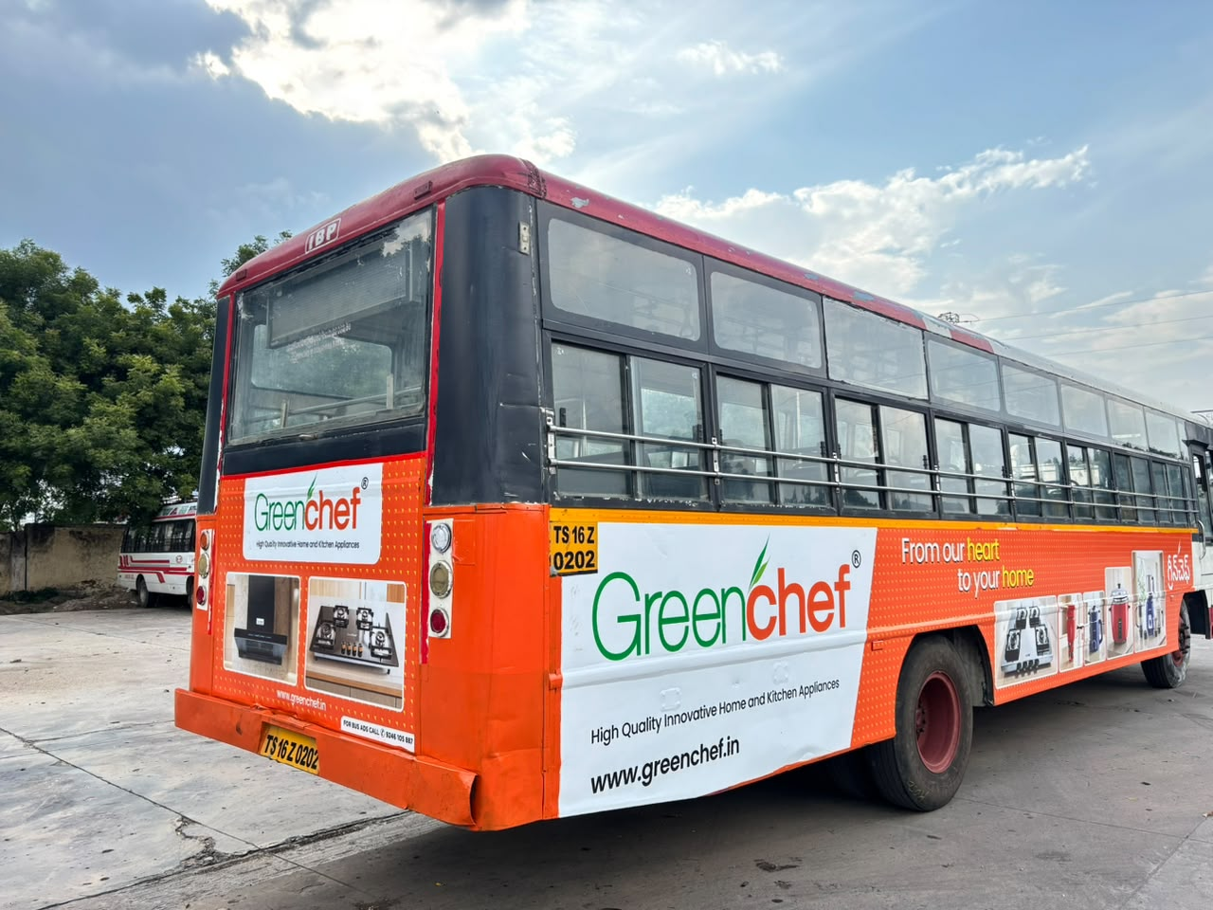
BUS ADS Rs.40000 Per Month + 7500 Mounting

Slide 16
Pricing
LED VAN ₹250000/Month 70 Kms 8 Hrs per day
Tata Ace ₹80000/Month 70 Kms 8 Hrs per day
T Shape ₹75000/Month 70 Kms 8 Hrs per day
Tricycle ₹1500/Day 5 Kilometres 7 Hrs
Look Walkers₹1500/Day 5 Kilometres 7 Hrs
AUTOTOPS Rs.650 Per Auto Min 500 for 1 Area
Auto Stickers Rs.120 Per Auto Min 500 for 1 Area
Equestrian Media Pvt. Ltd.

Slide 17
Why Brands Choose Equestrian Media
✔ Complete BTL Marketing Solutions
✔ Experienced & Professional Team
✔ Innovative Advertising Platforms
✔ Fast Campaign Execution
✔ Competitive Pricing
✔ Customized Brand Promotions
✔ Reliable Service & Support
✔ Strong Local Market Presence
✔ High Visibility & Maximum Reach
Equestrian Media Pvt. Ltd.

Slide 18
Contact
THANK YOU
Equestrian Media Pvt. Ltd.

